Slide 1
NTC LEAD Seminar
‘Ministry in Times of Disaster’
Rev. Linda Hamill
16.03.2018

Slide 2
The Ministry of Presence

Slide 3
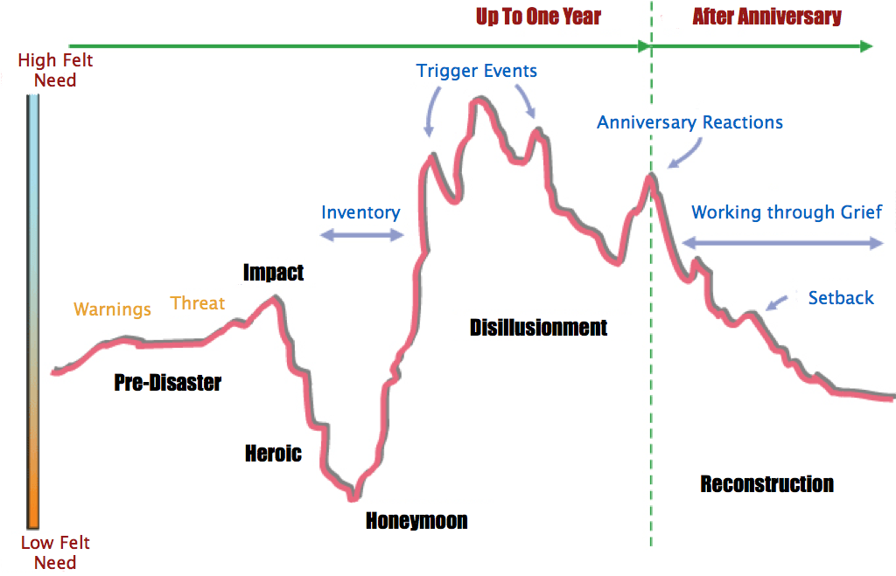
Level of felt need

Slide 4
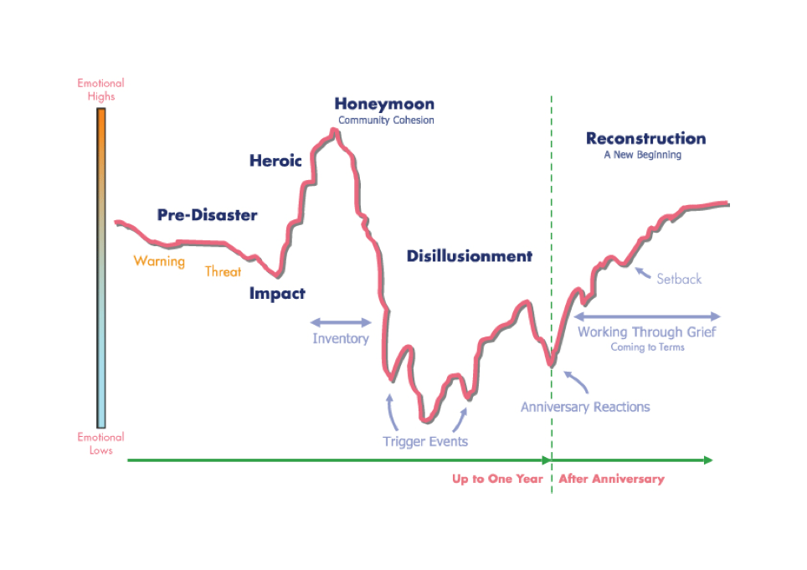
Mood
Need

