Slide 1
The Local Church as Priestly Community
reintegrating worship, life together and mission
Anne Klose

Slide 2
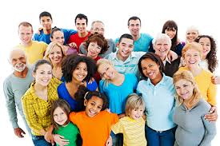
Family

Slide 3
New Testament Images of the People of God
ἐκκλησία (church/assembly/congregation called out by God)
God’s household/family
The body of Christ

Slide 4
Priesthood

Slide 5
The big picture
Creation & Fall
Covenant with Israel
CHRIST
New Covenant, New People
Final Redemption and New Creation

Slide 6
Why Priesthood?
Worship
Life Together
Priesthood
Mission (Sharing Blessing)

Slide 7
Covenant and its corporate priesthood
Priesthood
Covenant

Slide 8
The Basic Biblical Promise
‘Go from your country and your kindred and your father’s house to the land that I will show you. I will make of you a great nation, and I will bless you, and make your name great, so that you will be a blessing. I will bless those who bless you, and the one who curses you I will curse; and in you all the families of the earth shall be blessed.’ (Gen 12:1b-3)

Slide 9
‘I will establish my covenant between me and you, and your offspring after you throughout their generations, for an everlasting covenant, to be God to you and to your offspring after you. And I will give to you, and to your offspring after you, the land where you are now an alien, all the land of Canaan, for a perpetual holding; and I will be their God.’ (Gen 17:7-8)

Slide 10
The Lord said, ‘Shall I hide from Abraham what I am about to do, seeing that Abraham shall become a great and mighty nation, and all the nations of the earth shall be blessed in him? No, for I have chosen him, that he may charge his children and his household after him to keep the way of the Lord by doing righteousness and justice; so that the Lord may bring about for Abraham what he has promised him.’ (Gen 18:17-19)

Slide 11
Worship
Life Together
Priesthood
Mission (Sharing Blessing)

Slide 12
A Priestly kingdom
Then Moses went up to God; the Lord called to him from the mountain, saying, “Thus you shall say to the house of Jacob, and tell the Israelites: You have seen what I did to the Egyptians, and how I bore you on eagles’ wings and brought you to myself. Now therefore, if you obey my voice and keep my covenant, you shall be my treasured possession out of all the peoples. Indeed, the whole earth is mine, but you shall be for me a priestly kingdom and a holy nation. These are the words that you shall speak to the Israelites.”
(Exod 19:3-6)

Slide 13
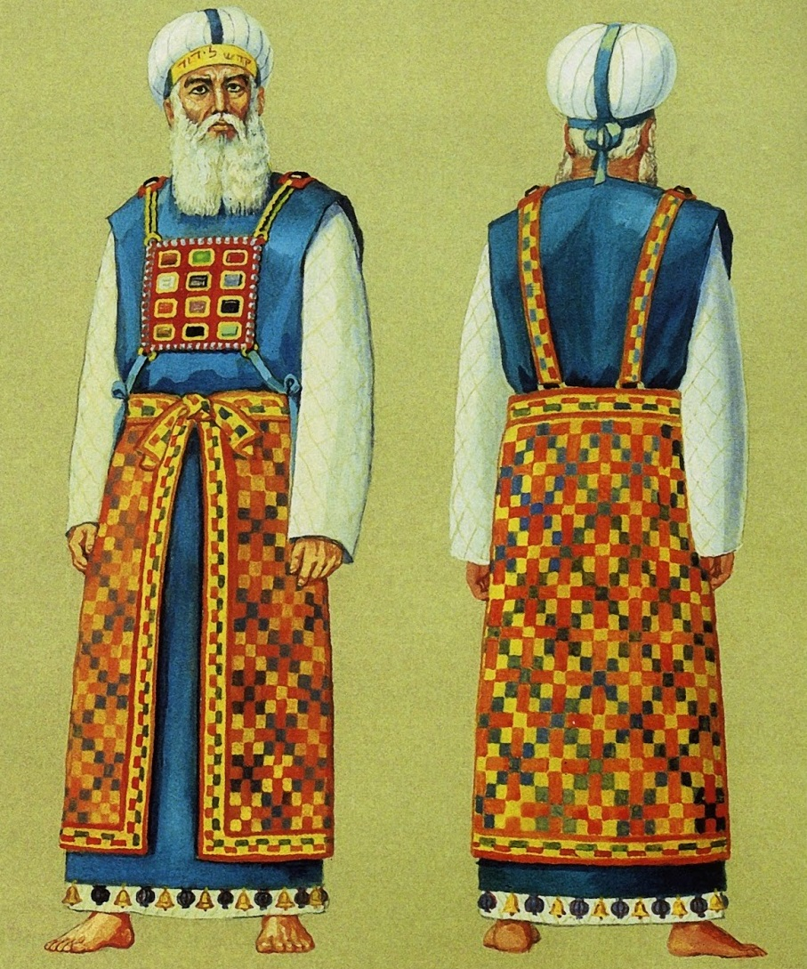
Israel’s priesthood
Representing the people in worship before YHWH
Representing YHWH
Speaking revelation, instruction, blessing, declaration
Representing the people
In remembrance, confession, intercession

Slide 14
Jesus as Perfect high priest
Perfect in his representation of humanity to God
Perfect in his representation of God to humanity
He is the reflection of God’s glory and the exact imprint of God’s very being… (Heb 1:3)
Therefore he had to become like his brothers and sisters in every respect, so that he might be a merciful and faithful high priest in the service of God, to make a sacrifice for the sins of the people. (Heb 2:17)

Slide 15
The doctrine of “the priesthood of all believers”
All humans have access to God through Christ, the true high priest, and thus do not need a priestly mediator.
…and since we have a great priest over the house of God, let us approach with a true heart in full assurance of faith (Heb 10:21-22)

Slide 16
The Priesthood of the new covenant
Come to him, a living stone, though rejected by mortals yet chosen and precious in God’s sight, and like living stones, let yourselves be built into a spiritual house, to be a holy priesthood, to offer spiritual sacrifices acceptable to God through Jesus Christ. (1 Pet 2: 4-5)

Slide 17
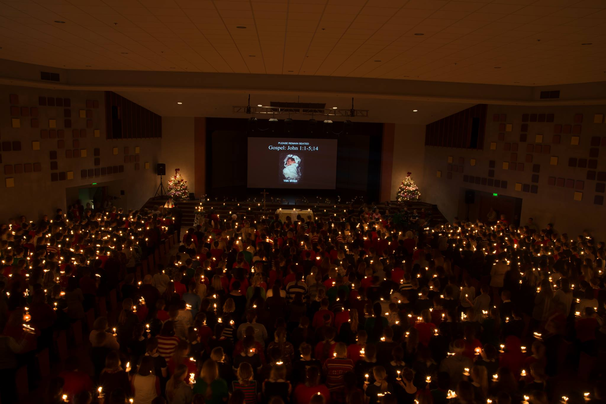
Why worship?

Slide 18
Summoned by god’s word
Learning to attend to right things rightly…

Slide 19
Corporate confession of sin
Widens and deepens our personal confession
Locates us in the fellowship of sinners
Grounds us in our missional solidarity with God’s world

Slide 20
Further Reading
Bonhoeffer, Dietrich. 1954. Life Together. NY: Harper & Row.
Hanson, Paul D. 2001. The People Called: The Growth of Community in the Bible. San Francisco: Harper & Row.
Hauerwas, Stanley, and Samuel Wells, eds. 2006. The Blackwell Companion to Christian Ethics. Malden, MA: Wiley-Blackwell.
Kenneson, Philip. 2004. ‘Gathering: Worship, Imagination, and Formation’. In The Blackwell Companion to Christian Ethics, edited by Stanley Hauerwas and Samuel Wells. Carlton, VIC: Blackwell Publishing.
Klose, Anne. 2018. Covenantal Priesthood: A Narrative of Community for Baptist Churches. Milton Keynes: Paternoster.
Liston, Greg. 2001. ‘The Dynamics of Trinitarian Worship’. New Zealand Journal of Baptist Research 6: 29–47.
McDonald, Suzanne. 2010. Re-Imaging Election: Divine Election as Representing God to Others and Others to God. Grand Rapids, MI: William B. Eerdmans.
Nelson, Richard D. 1993. Raising up a Faithful Priest: Community and Priesthood in Biblical Theology. Louisville, KY: Westminster John Knox.
Smith, James K. A. 2016. You Are What You Love: The Spiritual Power of Habit. Grand Rapids, MI: Brazos Press.
Wright, Christopher J.H. 2010. The Mission of God’s People: A Biblical Theology of the Church’s Mission. Grand Rapids, MI: Zondervan.
Wright, N. T. 1991. The Climax of the Covenant: Christ and the Law in Pauline Theology. Edinburgh: T&T Clark.

