Slide 1
Holiness in the 21st Century: Prophetic, Embodied, Embedded
Revd Dr Joseph Wood, Lecturer in Church History and Theology,
NTC Australia/New Zealand

Slide 2
What does it look like to be holy as God is holy in this story?
Biblical Illiteracy
Steve and Jessica
Sami

Slide 3
1. The Call to be holy as God is holy
The Language of holiness
How often do we use the word holy/holiness in our everyday language?
How many times have you said, sung or heard the word holy/holiness in church services over the past few months?

Slide 4
1. The Call to be holy as God is holy
‘Although many of the tightly held clichés, code words, symbolic acts, and catchphrases that the people of God have inherited and use today are beautiful and good, what if over time they have become so separated from the overarching story of God they have lost their original meanings?’ – Tim Green, The God Plot

Slide 5
1. The Call to be holy as God is holy
Holiness in the Bible
‘Different scholars emphasize different nuances of the word’s meaning, but all agree that holiness implies separation or otherness. The Latin suggests sanctification means to ‘make sacred’ or to ‘set apart’ for a sacred purpose.’ – Leclerc, Discovering Christian Holiness, 55

Slide 6
1. The Call to be holy as God is holy
Holiness in the Bible
Holiness is reconfigured in the Gospels. No longer is God far away; He is present, living and walking amongst his people. No longer is God speaking through the prophets, but he is speaking through the Son, ‘the exact imprint of God’s very being.’ (Hebrews 1.1-3)

Slide 7
1. The Call to be holy as God is holy
Holiness in the Bible
It is clear from this brief sketch that holiness in the NT is fully embodied in the person of Jesus, and fully expressed in his life, death, resurrection and ascension. And the call to be holy is not eliminated in the NT; it is re-oriented to the life of Christ: be Christlike as God is Christlike.

Slide 8
1. The Call to be holy as God is holy
Wesleyan Tradition
Holiness unto the Lord is our watchword, and song
Holiness unto the Lord, as we’re marching along
Sing it, shout it, loud and long!
Holiness unto the Lord, now and forever…

Slide 9
What does it mean to be holy as God is holy in our day?
We begin with a simple definition:
To be holy is to be like Christ.

Slide 10
2. Three offices of Christ: Prophet, Priest, and King
‘…the advantage in taking these metaphors as the organizing structure is that they do not focus our thinking just on what he did, but on who he is.’ – T A Noble, Holy Trinity: Holy People, Chapter 6

Slide 11
2. Three offices of Christ: Prophet, Priest, and King
When Jesus asked his disciples, ‘who do the people say I am?’, they replied, ‘Some say John the Baptist, but others Elijah, and still others Jeremiah or one of the prophets.’ (Matt 16.16)

Slide 12
2. Three offices of Christ: Prophet, Priest, and King
‘Prophets will have none of this. They hold that everything, absolutely everything, takes place on sacred ground.’ – Eugene Peterson, The Jesus Way, 120

Slide 13
2. Three offices of Christ: Prophet, Priest, and King
With prophetic imagination, Jesus proclaimed, ‘For this I was born, and for this I came into the world, to testify to the truth.’ (John 18.37)

Slide 14
2. Three offices of Christ: Prophet, Priest, and King
Without this, humanity’s identity as the people of God was compromised, for anything unclean or sinful, could not be in God’s presence. To be holy as God is holy required the priesthood.

Slide 15
2. Three offices of Christ: Prophet, Priest, and King
Jesus changes all of this. In Jesus, we see the holy other God, the transcendent, indescribable, eternal God, ‘give up his divine privileges and become a humble servant, being born a human being.’ He became incarnate, and made his home among us.

Slide 16
2. Three offices of Christ: Prophet, Priest, and King
‘My body connects me to all of these other people. Wearing my skin is not a solitary practice but one that brings me into communion with all these other embodied souls. It is what we have most in common with one another.’ – Barbara Brown Taylor, An Altar in the World, 42

Slide 17
2. Three offices of Christ: Prophet, Priest, and King
A leper came to him begging him, and kneeling he said to him, “If you choose, you can make me clean.” Moved with pity, Jesus stretched out his hand and touched him, and said to him, “I do choose. Be made clean!” Immediately the leprosy left him, and he was made clean. (Mark 1.40-42)

Slide 18
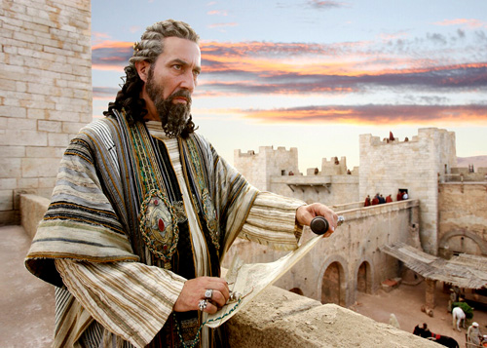
2. Three offices of Christ: Prophet, Priest, and King

Slide 19
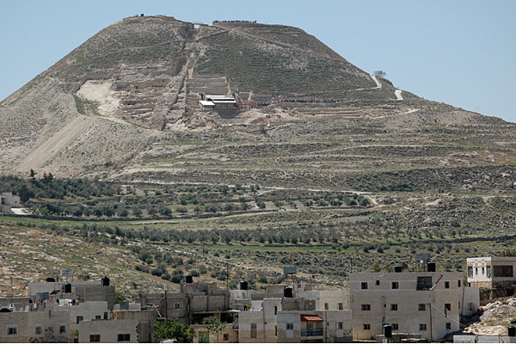
2. Three offices of Christ: Prophet, Priest, and King

Slide 20
2. Three offices of Christ: Prophet, Priest, and King
Herod’s Kingdom
Occupation, Oppression, Violence, Selfishness, Life-taking, Hopeless

Slide 21
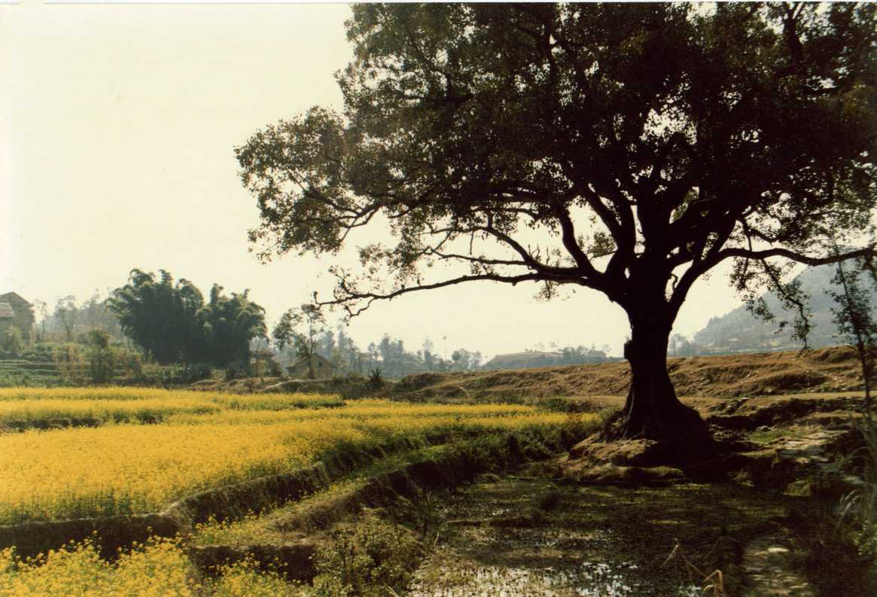
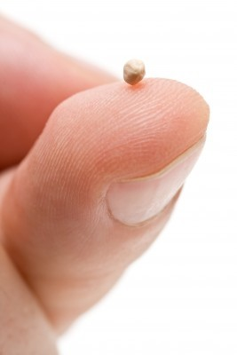
2. Three offices of Christ: Prophet, Priest, and King
Jesus’ Kingdom

Slide 22
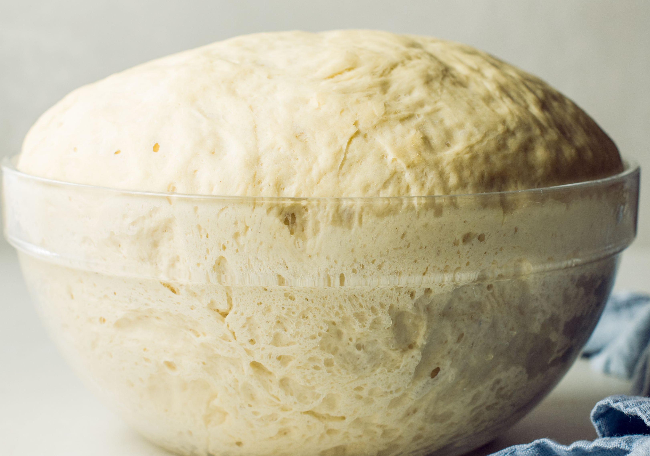
2. Three offices of Christ: Prophet, Priest, and King
Jesus’ Kingdom

Slide 23
2. Three offices of Christ: Prophet, Priest, and King
Jesus’ Kingdom is established not through violence and coercion, but through love and persuasion. It does not conquer from the outside in, but from the inside out.

Slide 24
2. Three offices of Christ: Prophet, Priest, and King
Jesus’ Kingdom
Embedding, Infectious, Transforming, Persuasive, Loving, Hopeful, Life-giving, Holy

Slide 25
2. Three offices of Christ: Prophet, Priest, and King
‘Through his resurrection, the defeat of death, Jesus announces his new royal authority. He is now the king who displaces the king.’ – Walter Bruggeman, Prophetic Imagination, 113

Slide 26
3. Who is the Church? The Body of Christ
‘It follows that the nature of the Church’s task can be defined by reference to the records of the public career of Jesus, His teaching and His acts and his offices.’ – TW Manson, The Church’s Ministry, 24-25

Slide 27
3. Who is the Church? The Body of Christ
If the Church is the Body of Christ, and if the Church is the continuation of the ministry of Christ, then what does the church look like through the lenses of Prophet, Priest and King. In other words, in what ways does the Church embody, as Christ’s Body, the three offices of Jesus.

Slide 28
3. Who is the Church? Prophetic, Embodied, Embedded
Using imagery, metaphors and creative stories, Jesus provoked the people’s imaginations to consider a world different to the one they saw in front of them.
Story 1 – Biblical Illiteracy

Slide 29
3. Who is the Church? Prophetic, Embodied, Embedded
‘One reason why the rich in general have so little sympathy for the poor is because they seldom visit them. Hence it is that, according to the common observation, one part of the world does not know what the other suffers.’ – John Wesley, On Visiting the Sick

Slide 30
3. Who is the Church? Prophetic, Embodied, Embedded
Story 2 – Steve and Jessica

Slide 31
3. Who is the Church? Prophetic, Embodied, Embedded
To be embedded is to know the culture we find ourselves in.
To be embedded is to be involved in our local communities.
To be embedded is to imagine what our local communities could look like if the Kingdom of God reigned.

Slide 32
3. Who is the Church? Prophetic, Embodied, Embedded
Story 3 - Sami

Slide 33
4. Conclusion
What is holiness in the 21st century?
It is the continued call of God on His people: be holy as I am holy.
It is a call to continue the ministry of Jesus: Prophet, Priest, King.
Empowered by the Spirit, it is a reflection of Christ: Prophetic, Embodied, Embedded.

Slide 34
Holiness in the 21st Century: Prophetic, Embodied, Embedded
Revd Dr Joseph Wood, Lecturer in Church History and Theology,
NTC Australia/New Zealand

